Slide 1

IMPLEMENTAREA CONCURENTEI IN LIMBAJE DE PROGRAMARE
CONCURENTA IN
JAVA
Ioana Leustean
https://docs.oracle.com/javase/tutorial/essential/concurrency/
https://docs.oracle.com/javase/specs/jls/se23/jls23.pdf
Overview (Java SE 23 & JDK 23) (oracle.com)

Slide 2
Modele de interactiuni concurente:
Dinning Philosophers
Producer - Consumer
Reader - Writer

Slide 3
Modelul de interactiune Cititori-Scriitori (Reader-Writers)
Mai multe threaduri au acces la o resursa.
Unele thread-uri scriu (writers), iar altele citesc (readers).
Resursa poate fi accesata simultan de mai multi cititori.
Resursa poate fi accesata de un singur scriitor.
Resursa nu poate fi accesata simultan de cititori si de scriitori

Slide 4
Interface ReadWriteLock
mentine o pereche de lacate: unul pentru citire si unul pentru scriere
lacatul pentru citire poate fi detinut de mai multe thread-uri simultan, daca nu exista o solicitare pentru scriere
lacatul pentru scriere poate fi detinut de un singur thread
interface Lock
interface ReadWriteLock extends Lock
class ReentrantReadWriteLock
metoda readLock() intoarce lacatul pentru cititori
metoda writeLock() intoarce lacatul pentru scriitori
ReadWriteLock (Java SE 23 & JDK 23) (oracle.com)

Slide 5
import java.util.concurrent.*;
import java.util.concurrent.locks.*;
public class ReaderWriter {
private static Integer counter = 0; // resursa
private static ReadWriteLock lock = new ReentrantReadWriteLock();
public static void main(String[] args) {
(new Thread(new TaskW())).start();
(new Thread(new TaskR())).start();
(new Thread(new TaskR())).start();
(new Thread(new TaskW())).start();
(new Thread(new TaskR())).start();
(new Thread(new TaskR())).start();
(new Thread(new TaskR())).start();
(new Thread(new TaskW())).start();
}

Slide 6
Thread-ul Writer
private static class TaskW implements Runnable {
public void run () {
lock.writeLock().lock();
try{
int temp = counter;
for (int i=0;i<5;i++) {counter++;
Thread.currentThread().sleep(1);}
System.out.println(Thread.currentThread().getName() +
" Writer - before: "+temp+" after:" + counter);}
catch (InterruptedException e){}
finally {
lock.writeLock().unlock();}
}}
// fiecare thread Writer incrementeaza contorul de 5 ori

Slide 7
Thread-ul Reader
private static class TaskR implements Runnable {
public void run () {
lock.readLock().lock();
try{
System.out.println(Thread.currentThread().getName() + "Reader counter:" + counter);}
finally { lock.readLock().unlock();}
}}}

Slide 8
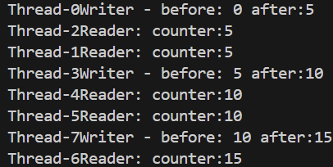
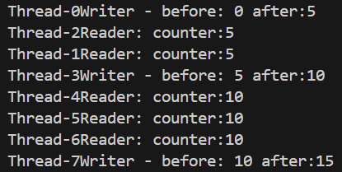
Modelul de interactiune Cititori-Scriitori (Reader-Writers)

Slide 9
Semafor cu cantitate (quantity semaphore)
public class Semaphore
extends Object
Semaphore(int permits) // constructor
implementeaza un semafor cu cantitate
care coordoneaza accesul la un numar precizat de resurse
metoda aquire() / acquire(int permits)
thread-ul care apeleaza aquire cere accesul la o resursa;
daca nu sunt resurse, thread-ul este blocat
metoda release() / release(int permits)
thread-ul care apeleaza release elibereaza accesul la o resursa
Semaphore sem = new Semaphore(n);
sem.acquire();
... //sectiune critica
sem.release();
Semaphore (Java SE 23 & JDK 23) (oracle.com)

Slide 10
public class Semaphore
extends Object
Semaphore(int permits) // constructor
Semaphore sem = new Semaphore(n);
sem.acquire();
... //sectiune critica
sem.release();
Diferenta dintre un obiect construit cu Semaphore(1) si unul din clasa Lock este urmatoarea:
lacatul intern al obiectului din clasa Semaphore este eliberat de orice thread care face release
lacatul intern al obiectului din clasa Lock este eliberat numai de thread-ul care il detine
Varianta Semaphore(int permits, true) thread-urile care asteapta sa faca aquire sunt FIFO
https://docs.oracle.com/en/java/javase/23/docs/api/java.base/java/util/concurrent/Semaphore.html

Slide 11
Exemplu:
un semafor coordoneaza accesul la 3 resurse
exista 4 thread-uri care cer accesul la resursa
dupa ce primeste accesul, fiecare thread executa 3 task-uri, apoi elibereaza resursa
public class Semaphores{
static Semaphore semaphore = new Semaphore(3);
static class MyThread extends Thread {
// thread-ul va face aquire, va executa task-urile, apoi va face release
}
public void main(String[] args) { …}
}
public static void main(String[] args) {
MyThread t1 = new MyThread("A"); t1.start();
…..
MyThread t4 = new MyThread("D"); t4.start();
}
http://winterbe.com/posts/2015/04/30/java8-concurrency-tutorial-synchronized-locks-examples/

Slide 12
static class MyThread extends Thread {
String name = "";
MyThread(String name) { this.name = name;}
public void run() {
try {
semaphore.acquire();
try {
for (int i = 1; i <= 3; i++) {
System.out.println(name + " : is performing operation " + i }
Thread.sleep(ThreadLocalRandom.current().nextInt(1000));}
} finally { semaphore.release();}
} catch (InterruptedException e) {}
}}
aquire pune thread-urile in asteptare,
deci poate arunca o exceptie

Slide 13
public class Semaphores{
static Semaphore semaphore = new Semaphore(3);
static class MyThread extends Thread {…}
public void main(String[] args) {
MyThread t1 = new MyThread("A"); t1.start();
MyThread t2 = new MyThread("B"); t2.start();
MyThread t3 = new MyThread("C"); t3.start();
MyThread t4 = new MyThread("D"); t4.start();
}}

Slide 14
static Semaphore semaphore = new Semaphore(3);
static class MyThread extends Thread {
String name = "";
MyThread(String name) { this.name = name;}
public void run() {
try {
semaphore.acquire(2); // are nevoie de 2 resurse pentru executie
try {…
} finally { semaphore.release(1);}
} catch (InterruptedException e) {}
}}
public void main(String[] args) {
MyThread t1 = new MyThread("A"); t1.start();
MyThread t2 = new MyThread("B"); t2.start();
MyThread t3 = new MyThread("C"); t3.start();
MyThread t4 = new MyThread("D"); t4.start();
}
Thread-urile B si D nu au cum sa faca acquire pe 2 resurse

Slide 15
Crearea obiectelor de tip Thread:
Metoda directa
ca subclasa a clasei Thread
implementarea interfetei Runnable
Metoda abstracta
folosind interfata Executor
public interface Runnable{
public void run() ;
}
public class Thread
extends Object
implements Runnable
interface Executor
public interface ExecutorService
extends Executor
public class Executors
extends Object

Slide 16
Framework-ul Executor
interface Executor
public interface ExecutorService
extends Executor
public class Executors
extends Object
ExecutorService asigura crearea si managementul unei piscine de thread-uri.
ExecutorService pool = Executors.newCachedThreadPool()
pool.execute( instanta Runnable )
Crearea thread-urilor
crerea unui piscine de thread-uri folosind
o metoda a clasei Executors (care intoarce o
instanta a interfetei ExecutorService)
https://download.java.net/java/early_access/valhalla/docs/api/java.base/java/util/concurrent/Executors.html

Slide 17
interface Executor
public interface ExecutorService extends Executor
public class Executors extends Object
Metode ale clasei Executors:
newSingleThreadExecutor()
"Creates an Executor that uses a single worker thread operating off an unbounded queue. (Note however that if this single thread terminates due to a failure during execution prior to shutdown, a new one will take its place if needed to execute subsequent tasks.)"
Un thread (normal) executa un singur task, dar un thread creat cu aceasta metoda poate executa secvential o serie de task-uri.
newCachedThreadPool()
"Creates a thread pool that creates new threads as needed, but will reuse previously constructed threads
when they are available. These pools will typically improve the performance of programs that execute many short-lived asynchronous tasks."
newFixedThreadPool(poolSize)
"Creates a thread pool that reuses a fixed number of threads operating off a shared unbounded queue.
At any point, at most n Threads threads will be active processing tasks. If additional tasks are submitted when all threads are active, they will wait in the queue until a thread is available."

Slide 18
interface Executor
public interface ExecutorService extends Executor
public class Executors extends Object
Metode ale clasei Executors:
newSingleThreadExecutor()
newCachedThreadPool()
newFixedThreadPool(poolSize)
Metode ale interfetei ExecutorService
shutdown()
serviciul nu primeste task-uri noi, dar executa task-urile deja primite
shutdownNow()
terminarea serviciului, fara a permite finalizarea executiilor
awaitTermination(long timeout, TimeUnit unit)
pentru a permite finalizarea executiilor, impunand o limita temporara

Slide 19
Metode sincronizate
doua thread-uri care incrementeaza acelasi contor
public class Task implements Runnable {
static Integer counter = 0;
public void run () {
for (int i = 0; i < 5; i++) {
performTask();
}}
private synchronized void performTask () {
int temp = counter;
counter++;
System.out.println(Thread.currentThread()
.getName() + " - before: "+temp+" after:" + counter);}
public static void main (String[] args) {.. }}

Slide 20
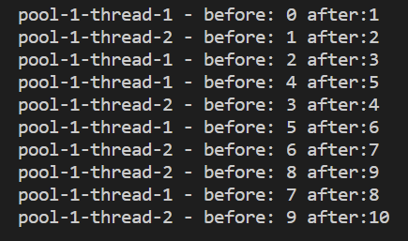

Generarea thread-urilor folosind Executor
public static void main (String[] args) {
Thread thread1 = new Thread(new Task());
Thread thread2 = new Thread(new Task()); thread1.start(); thread2.start();
thread1.join(); thread2.join(); }
import java.util.concurrent.*;
public static void main (String[] args) {
ExecutorService pool = Executors.newCachedThreadPool();
for(int i=0;i<2;i++) {pool.execute(new Task());}
pool.shutdown();
}

Slide 21
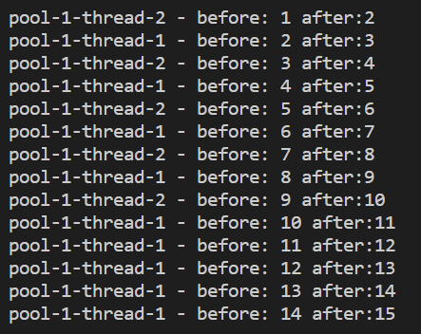
public static void main (String[] args) {
ExecutorService pool = Executors.newFixedThreadPool(2);
for(int i=0;i<3;i++) {pool.execute(new Task());}
demo.shutdown();
}
in metoda run a clasei Task contorul
e incrementat de 5 ori
sunt create 2 thread-uri, dar
avem 3 task-uri, deci
un thread executa 2 task-uri

Slide 22
shutdown() cu awaitTermination()
import java.util.concurrent.*;
public static void main (String[] args) throws InterruptedException {
ExecutorService pool = Executors.newCachedThreadPool();
for(int i=0;i<2;i++) {pool.execute(new Task());}
pool.shutdown();
try {
if (!pool.awaitTermination(3500, TimeUnit.MILLISECONDS)) {
pool.shutdownNow(); }
} catch (InterruptedException e) { pool.shutdownNow();}
}
awaitTermination()
Blocks until all tasks have completed execution after a shutdown request,
or the timeout occurs, or the current thread is interrupted, whichever happens first.

Slide 23
Exemplu: ReaderWriter - generarea thread-urilor folosind Executor
import java.util.concurrent.*;
import java.util.concurrent.locks.*;
public class ReaderWriterE{
private static Integer counter = 0;
private static final ReadWriteLock lock = new ReentrantReadWriteLock();
public static void main (String[] args) {
ExecutorService pool = Executors.newCachedThreadPool();
pool.execute(new TaskW());
pool.execute(new TaskR());
pool.execute(new TaskW());
pool.execute(new TaskR());
pool.execute(new TaskR());
pool.shutdown();
}

Slide 25
Callable si Future
public interface Runnable {
public void run();
}
public interface Callable <ResultType> {
ResultType call() throws Exception;
}
executa un thread
intoarce rezultatul executiei unui thread
Callable<ResultType> callable = new Callable<ResultType>() {
public String call() throws Exception {
// executie care dureaza
return result;
}};
ExecutorService exec=Executor.newSingleThreadExecutor
Future<ResultType> future = exec.submit(callable)
un obiect Callable intoarce un obiect Future
https://www.callicoder.com/java-callable-and-future-tutorial/

Slide 26
Callable si Future
Callable<String> callable = new Callable<String>() {
public String call() throws Exception {
// Perform some computation
Thread.sleep(2000);
return "Return some result";
}};
public static void main (String[] args) throws Exception{
ExecutorService exec=Executor.newSingleThreadExecutor();
Future<String> future = exec.submit(callable) ;
…
}
Callable reprezinta o executie asincrona,
al carei rezultat este recuperate cu ajutorul
unui obiect Future

Slide 27
Executie asincrona
implementarea unei instante a clasei Callable care intoarce un <String>
instanta va fi folosita pentru a crea un obiect Future
private static class TaskCallable implements Callable<String> {
private static int ts;
public TaskCallable (int ts) {this.ts = ts;}
public String call () throws InterruptedException {
System.out.println("Entered Callable; sleep:"+ts);
Thread.sleep(ts);
return "Hello from Callable";
}
}
Callable reprezinta o executie asincrona,
al carei rezultat este recuperate cu ajutorul
unui obiect Future
ExecutorService executorService = Executors.newSingleThreadExecutor();
Future<String> futureEx =executorService.submit(new TaskCallable(time));
https://www.callicoder.com/java-callable-and-future-tutorial

Slide 28
Future (rezultatul unei executii asincrone)
ExecutorService.submit() intoarce imediat, returnand un obiect Future.
Din acest moment se pot executa diferite task-uri in parallel cu cea executata de obiectul Future.
Rezultatul returnat de obiectul Future este obtinut apeland future.get().
Metoda get() a obiectelor Future va bloca thread-ul care o apeleaza pana cand se returneaza obiectului Future; daca task-ul executat este anulat sau thread-ul current este intrerupt, metoda get() arunca exceptii.
Metoda isDone() a obiectelor Future poate fi apelata pentru a vedea daca obiectul si-a terminat de executat task-ul.

Slide 29
import java.util.concurrent.*;
public class CallableFuture{
public static void main (String[] args) throws Exception{
ExecutorService pool = Executors.newSingleThreadExecutor();
int time = ThreadLocalRandom.current().nextInt(1000, 5000);
System.out.println("Creating the future");
Future<String> futureEx = pool.submit(new TaskCallable(time));
System.out.println("Do something else while callable is getting executed");
Thread.currentThread().sleep(time);
System.out.println("Retrieve the result of the future");
String result = futureEx.get();
System.out.println(result);
pool.shutdown(); }
https://www.callicoder.com/java-callable-and-future-tutorial/

Slide 30
public static void main (String[] args) throws Exception{
ExecutorService pool = Executors.newSingleThreadExecutor();
int time = ThreadLocalRandom.current().nextInt(1000, 5000);
System.out.println("Creating the future");
Future<String> futureEx = pool.submit(new TaskCallable(time));
System.out.println("Do something else while callable is getting executed");
while(!futureEx.isDone()) {
System.out.println("Task is still not done...");
Thread.sleep(200);
}
System.out.println("Retrieve the result of the future");
String result = futureEx.get();
System.out.println(result);
pool.shutdown();
}

Slide 31
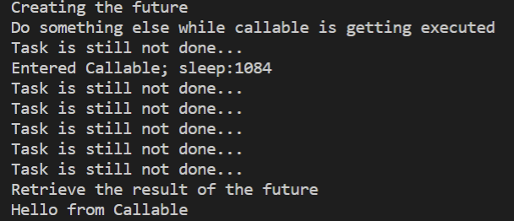
public static void main (String[] args) throws Exception{
ExecutorService pool = Executors.newSingleThreadExecutor();
int time = ThreadLocalRandom.current().nextInt(1000, 5000);
System.out.println("Creating the future");
Future<String> futureEx = pool.submit(new TaskCallable(time));
System.out.println("Do something else while callable is getting executed");
while(!futureEx.isDone()) {
System.out.println("Task is still not done...");
Thread.sleep(200);
}
System.out.println("Retrieve the result of the future");
String result = futureEx.get();
System.out.println(result);
pool.shutdown();
}
Callable reprezinta o executie asincrona,
al carei rezultat este recuperate cu ajutorul
unui obiect Future

Slide 32
public static void main (String[] args) throws Exception{
ExecutorService pool = Executors.newSingleThreadExecutor();
int time = ThreadLocalRandom.current().nextInt(1000, 5000);
System.out.println("Creating the future");
Future<String> futureEx = pool.submit( ()->{ try {Thread.sleep(time);}
catch (InterruptedException e) {System.out.println("error");}
finally {return "Hello from Callable!";}}
);
System.out.println("Do something else while callable is getting executed");
while(!futureEx.isDone()) {
System.out.println("Task is still not done...");
Thread.sleep(200);
}
System.out.println("Retrieve the result of the future");
String result = futureEx.get();
System.out.println(result);
pool.shutdown();
}
Java 8
argumentul lui submit este o functie anonima

Slide 33
CompletableFuture
public static void main (String[] args) throws Exception{
ExecutorService pool = Executors.newSingleThreadExecutor();
int time = ThreadLocalRandom.current().nextInt(1000, 5000);
System.out.println("Creating the future");
Future<String> futureEx = pool.submit( ()->{ try {Thread.sleep(time);}
catch (InterruptedException e) {System.out.println("error");}
finally {return "Hello from Callable!";}} );
CompletableFuture.runAsync(()->{
try {Thread.sleep(1000);} catch (InterruptedException e){System.out.println("error");}
finally {System.out.println("Hello from Completable Future!");}});
System.out.println("Do something else while callable is getting executed");
while(!futureEx.isDone()) {
System.out.println("Task is still not done..."); Thread.sleep(200);}
System.out.println("Retrieve the result of the future");
String result = futureEx.get();
System.out.println(result);
pool.shutdown(); }

Slide 34
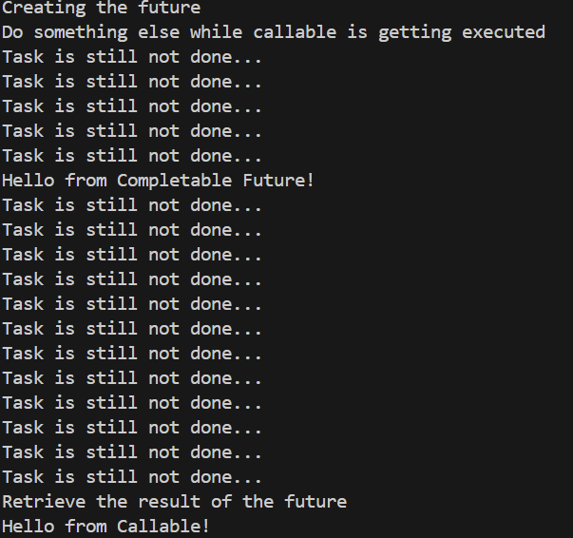
CompletableFuture implementeaza interfata Future si reprezinta o executie asincrona
public static void main (String[] args) throws Exception{
ExecutorService pool = Executors.newSingleThreadExecutor();
int time = ThreadLocalRandom.current().nextInt(1000, 5000);
System.out.println("Creating the future");
Future<String> futureEx = pool.submit( ()->{ try {Thread.sleep(time);}
catch (InterruptedException e) {System.out.println("error");}
finally {return "Hello from Callable!";}} );
CompletableFuture.runAsync(()->{
try {Thread.sleep(1000);} catch (InterruptedException e){System.out.println("error");}
finally {System.out.println("Hello from Completable Future!");}});
System.out.println("Do something else while callable is getting executed");
while(!futureEx.isDone()) {
System.out.println("Task is still not done..."); Thread.sleep(200);}
System.out.println("Retrieve the result of the future");
String result = futureEx.get();
System.out.println(result);
pool.shutdown(); }

Slide 35
CompletableFuture reprezinta o executie asincrona care poate fi completata
public static void main (String[] args) throws Exception{
ExecutorService pool = Executors.newSingleThreadExecutor();
int time = ThreadLocalRandom.current().nextInt(1000, 5000);
System.out.println("Creating the future");
Future<String> futureEx = pool.submit( ()->{ try {Thread.sleep(time);}
catch (InterruptedException e) {System.out.println("error");}
finally {return "Hello from Callable!";}} );
CompletableFuture.runAsync(()->{
try {Thread.sleep(1000);} catch (InterruptedException e){System.out.println("error");}
finally {return "Hello from Completable Future!");}}. thenAccept((String s)->
{System.out.println(s);});
System.out.println("Do something else while callable is getting executed");
while(!futureEx.isDone()) {
System.out.println("Task is still not done..."); Thread.sleep(200);}
System.out.println("Retrieve the result of the future");
String result = futureEx.get();
System.out.println(result);
pool.shutdown(); }

Slide 36
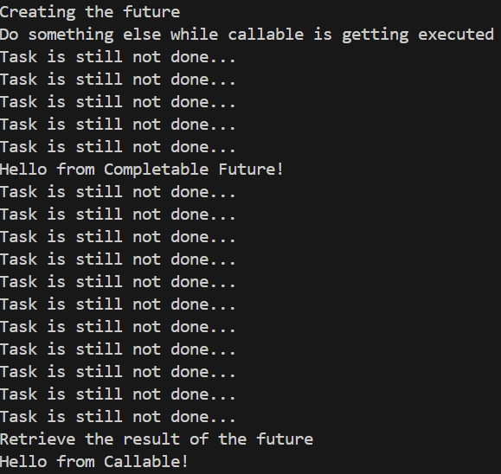
CompletableFuture reprezinta o executie asincrona care poate fi completata
public static void main (String[] args) throws Exception{
ExecutorService pool = Executors.newSingleThreadExecutor();
int time = ThreadLocalRandom.current().nextInt(1000, 5000);
System.out.println("Creating the future");
Future<String> futureEx = pool.submit( ()->{ try {Thread.sleep(time);}
catch (InterruptedException e) {System.out.println("error");}
finally {return "Hello from Callable!";}} );
CompletableFuture.runAsync(()->{
try {Thread.sleep(1000);} catch (InterruptedException e){System.out.println("error");}
finally {return "Hello from Completable Future!");}}. thenAccept(
(String s)->{System.out.println(s);});
System.out.println("Do something else while callable is getting executed");
while(!futureEx.isDone()) {
System.out.println("Task is still not done..."); Thread.sleep(200);}
System.out.println("Retrieve the result of the future");
String result = futureEx.get();
System.out.println(result);
pool.shutdown(); }
thread-ul principal nu este
blocat asteptand rezultatul

Slide 37
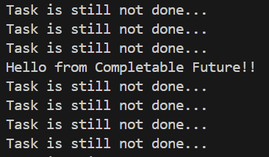
CompletableFuture reprezinta o executie asincrona care poate fi completata: thenApply(), thenAccept()
public static void main (String[] args) throws Exception{
ExecutorService pool = Executors.newSingleThreadExecutor();
int time = ThreadLocalRandom.current().nextInt(1000, 5000);
System.out.println("Creating the future");
Future<String> futureEx = pool.submit( ()->{ try {Thread.sleep(time);}
catch (InterruptedException e) {System.out.println("error");}
finally {return "Hello from Callable!";}} );
CompletableFuture.runAsync(()->{
try {Thread.sleep(1000);} catch (InterruptedException e) {System.out.println("error");}
finally {return "Hello from Completable Future!");}}. thenApply(
(String s)-> s+"!"). thenAccept(
(String s)->{System.out.println(s);});
System.out.println("Do something else while callable is getting executed");
while(!futureEx.isDone()) {
System.out.println("Task is still not done..."); Thread.sleep(200);}
System.out.println("Retrieve the result of the future");
String result = futureEx.get();
System.out.println(result);
pool.shutdown(); }
rezultatul a fost transformat
cu ajutorul unei functii,
iar noul rezultat a fost prelucrat

Slide 38
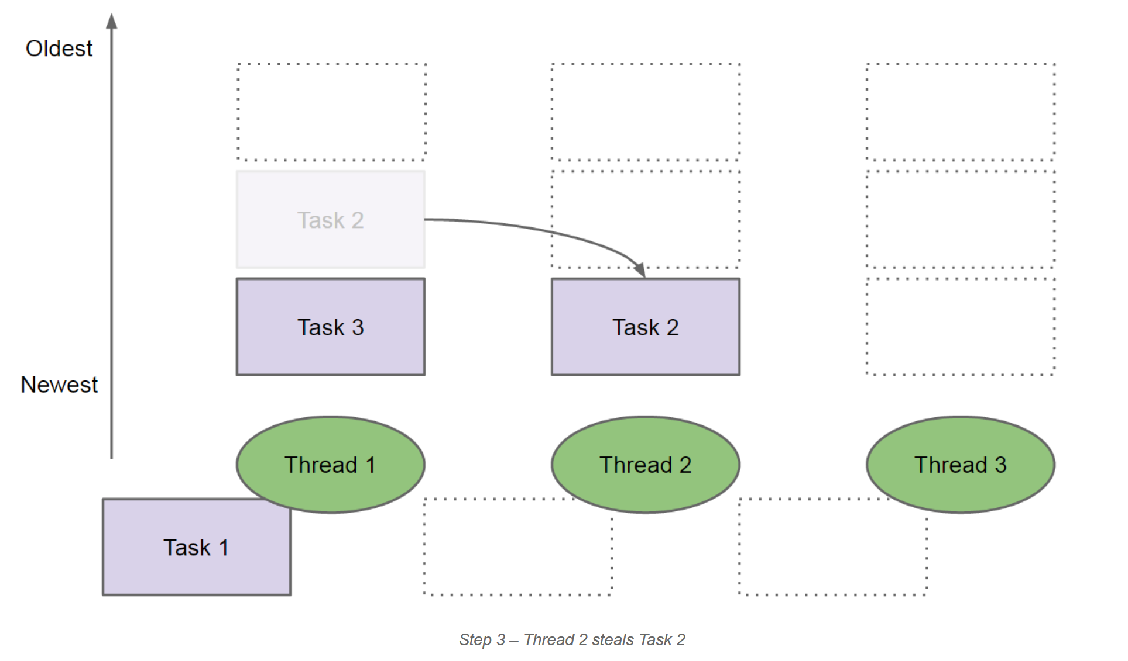
Fork-Join Framework
http://www.javacreed.com/java-fork-join-example/
A ForkJoinPool differs from other kinds of ExecutorService mainly by virtue of employing work-stealing: all threads in the pool attempt to find and execute tasks submitted to the pool and/or created by other active tasks (eventually blocking waiting for work if none exist).
ForkJoinPool (Java SE 23 & JDK 23)

Slide 39
Fork-Join Framework
public class ForkJoinPool
extends AbstractExecutorService
Diferenta dintre o piscine din clasa ForkJoinPool si cele create de alte servicii
Executor este implementarea unei metode de "work-stealing".
class AbstractExecutorService
extends Object
implements ExecutorService
Java 9 Concurrency Cookbook
The core of the fork/join framework is formed by the following two classes:
ForkJoinPool: This class implements the ExecutorService interface and the
work-stealing algorithm. It manages the worker threads and offers information
about the status of the tasks and their execution.
ForkJoinTask: This is the base class of the tasks that will execute in
the ForkJoinPool. It provides the mechanisms to execute the fork() and
join() operations inside a task and the methods to control the status of the
tasks. Usually, to implement your fork/join tasks, you will implement a subclass
of three subclasses of this class:
RecursiveAction for tasks with no return result,
RecursiveTask for tasks that return one result.
Documentatie:
ForkJoinPool (Java SE 23 & JDK 23)
https://www.researchgate.net/publication/2609854_A_Java_ForkJoin_Framework

Slide 40
Daca
- Thread1 executa Task1
- Task1 creaza Task2 si Task3 si
are nevoie de rezultatele lor pentru a continua
atunci
-Thread1 pune in asteptare Task1 si va pune in
coada proprie Task2 si Task3
- Thread1 va fi liber pentru a executa un task,
celalalt va fi furat de un alt thread liber
http://www.javacreed.com/java-fork-join-example/

Slide 41
Fork-Join Framework
Crerea piscinei de threaduri
Crearea task-ului
Task-ul este trimis piscinei folosind
invoke() - semantic echivalenta cu fork();join()
- trimite task-ul in executie si intoarce rezultatul
- executia incepe in thread-ul current
invokeAll() - trimite spre executie o lista de task-uri si
intoarce cand toate si-au terminat executia
public class ForkJoinPool
extends AbstractExecutorService
Crearea piscinei de thread-uri
ForkJoinPool fjpool = ForkJoinPool.commonPool() // recomandat,
// incearca sa foloseasca toate procesoarele disponibile
ForkJoinPool fjpool = new ForkJoinPool() // new ForkJoinPool(5)
Crerea task-urilor
public abstract class RecursiveAction
extends ForkJoinTask<Void>
public abstract class ForkJoinTask<V>
extends Object
implements Future<V>
metoda compute
implementeaza actiunea
executata de task
public abstract class RecursiveTask<V>
extends ForkJoinTask<V>

Slide 42
Fork-Join Framework: ForkJoinTask<V>
public class ForkJoinRecAc extends RecursiveAction {
public ForkJoinRecAc (long workLoad) {
this.workLoad = workLoad;
}
protected void compute() {
……
}}
public static void main (String[] args){
ForkJoinPool fjpool = ForkJoinPool.commonPool(4)
ForkJoinRecAc fjaction= new ForkJoinRecAc(workLoad);
fjpool.invoke(fjaction);}
public class ForkJoinRecTk extends RecursiveTask<T> {
public ForkJoinRecTk (long workLoad) {
this.workLoad = workLoad;
}
protected <T> compute() {
……
}}
public static void main (String[] args){
ForkJoinPool fjpool = ForkJoinPool.commonPool(4)
ForkJoinRecTk fjtask= new ForkJoinRecTk(workLoad);
<T> result = fjpool.invoke(fjtask);}
In exemple folosim:
http://tutorials.jenkov.com/java-util-concurrent/java-fork-and-join-forkjoinpool.html
http://www.baeldung.com/java-fork-join

Slide 43
Fork-Join Framework cu RecursiveAction (forma generala)
public class MyRecursiveAction extends RecursiveAction {
public MyRecursiveAction (long workLoad) {
this.workLoad = workLoad;
}
protected void compute() {
if (this.workLoad > limit) {…
List<MyRecursiveAction> subtasks = new ArrayList<MyRecursiveAction>();
subtasks.addAll(createSubtasks());
invokeAll(subtasks);}
}
else {// prelucrata de thread-ul curent}
}
private List<MyRecursiveAction> createSubtasks() {
List<MyRecursiveAction> subtasks = new ArrayList<MyRecursiveAction>();
…. }
invokeAll(Collection<T> tasks)
Trimite in executie toate task-urile
(face fork() pe toate task-urile)

Slide 44
Exemplu: crearea subtask-urilor
private List<MyRecursiveAction> createSubtasks() {
List<MyRecursiveAction> subtasks = new ArrayList<MyRecursiveAction>();
MyRecursiveAction subtask1 = new MyRecursiveAction(this.workLoad / 2);
MyRecursiveAction subtask2 = new MyRecursiveAction(this.workLoad / 2);
subtasks.add(subtask1);
subtasks.add(subtask2);
return subtasks;
}

Slide 45
Exemplu: Fork-Join Framework cu RecursiveAction
protected void compute() {
if (this.workLoad > 15) {
System.out.println("Splitting workLoad : " + this.workLoad);
List<MyRecursiveAction> subtasks = new ArrayList<MyRecursiveAction>();
subtasks.addAll(createSubtasks()); invokeAll(subtasks);}
else {
System.out.println("Doing workLoad myself: " + this.workLoad);
}
}

Slide 46
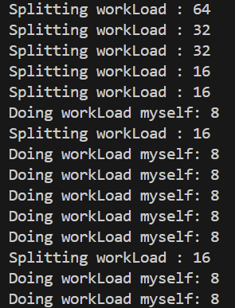
Exemplu: Fork-Join Framework cu RecursiveAction
public static void main (String[] args){
ForkJoinPool forkJoinPool = new ForkJoinPool(4);
MyRecursiveAction myRecursiveAction = new MyRecursiveAction(64);
forkJoinPool.invoke(myRecursiveAction);
}}

Slide 47
Fork-Join Framework cu RecursiveTask <T> (forma generala)
public class MyRecursiveTask extends RecursiveTask <T> {
public MyRecursiveTask (long workLoad) {
this.workLoad = workLoad;
}
protected T compute() {
if (this.workLoad > limit) {…..
List<MyRecursiveTask> subtasks = new ArrayList<MyRecursiveTask>();
subtasks.addAll(createSubtasks());
invokeAll(subtasks);
return joinresult(subtasks);}
else {// prelucrata de thread-ul current;
return result}}
private List<MyRecursiveTask> createSubtasks() {
List<MyRecursiveTask> subtasks = new ArrayList<MyRecursiveTask>(); …. }
joinresult(subtasks) calculeaza rezultatul
rezultatele subtaskurilor se obtin cu subtask.get()

Slide 48
Exemplu: Fork-Join Framework cu RecursiveTask<V>
protected Integer compute() {
if(this.workLoad > 15) {
System.out.println("Splitting workLoad : " + this.workLoad);
List<MyRecursiveTask> subtasks = new ArrayList<MyRecursiveTask>();
subtasks.addAll(createSubtasks());
invokeAll(subtasks);
int result = 0;
try{
for(MyRecursiveTask subtask : subtasks) { result = result + 2* subtask.get();}
System.out.println("Partial result: " + result);
} catch (InterruptedException | ExecutionException e) {};
return result; }
else {System.out.println("Doing workLoad myself: " + this.workLoad);
return workLoad;}
}
joinresult(subtasks) calculeaza rezultatul
rezultatele subtaskurilor se obtin cu subtask.get()

Slide 49
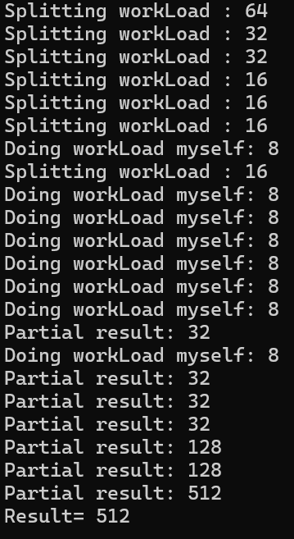
Exemplu: Fork-Join Framework pool cu RecursiveTask
public static void main (String[] args){
ForkJoinPool forkJoinPool = ForkJoinPool.commonPool();
MyRecursiveTask myRecursiveTask = new MyRecursiveTask(64);
int res = forkJoinPool.invoke(myRecursiveTask);
System.out.println("Result= " + res);}

Slide 50
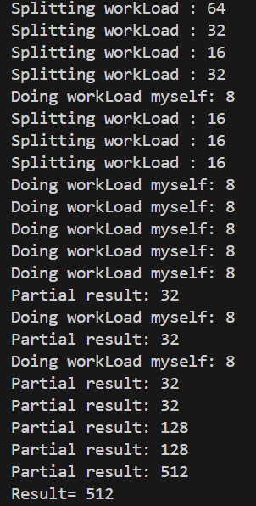
Exemplu program: ForkJoin pool cu RecursiveTask
ForkJoin pool cu RecursiveAction

